Slide 1
Multiple Disease Prediction

Slide 2
Team Members
Ritvik Kumar Singh [RA2011003010228]
Tanya Singh [RA2011003010231]
Shatakshi Pathak [RA2011003010235]

Slide 3
Problem Statement
In the current healthcare system, doctors diagnose and treat diseases based on symptoms presented by patients during their visit. However, early detection of diseases can significantly improve treatment outcomes and reduce healthcare costs. This project aims to develop a multiple disease prediction model using logistic regression that can assist healthcare professionals in identifying potential diseases early.

Slide 4
Objective
The objective of this project is to build a multiple disease prediction model using logistic regression. The model will be trained on a dataset of patient records and will predict the likelihood of a patient having one of several diseases based on their symptoms and medical history.

Slide 5
Hardware Requirements
The hardware requirements for this project are minimal.
A computer with at least 8GB of RAM and a quad-core processor should suffice. However, the more powerful the computer, the faster the training and testing of the model will be.

Slide 6
Software Requirements:
The software requirements for this project are as follows:
Python 3.6 or higher
NumPy, Pandas, Scikit-learn, and Matplotlib libraries
Google Colab or another IDE for coding and testing
Git and GitHub for version control

Slide 7
Implementation
Code:-
import numpy as np
import pandas as pd
from sklearn.model_selection import train_test_split
from sklearn import svm
from sklearn.metrics import accuracy_score
from sklearn.model_selection import train_test_split
from sklearn.linear_model import LogisticRegression
#Parkinsons
parkinsons_data = pd.read_csv('/content/parkinsons.csv’)
parkinsons_data.head()
parkinsons_data.shape
parkinsons_data.isnull().sum()
parkinsons_data['status'].value_counts()
parkinsons_data.groupby('status').mean()

Slide 8
X = parkinsons_data.drop(columns=['name','status'], axis=1)
Y = parkinsons_data['status']
X_train, X_test, Y_train, Y_test = train_test_split(X, Y, test_size=0.2, random_state=2)
print(X.shape, X_train.shape, X_test.shape)
#Model Training
#Support Vector Machine Model
model = svm.SVC(kernel='linear')
model.fit(X_train, Y_train)
X_train_prediction = model.predict(X_train)
training_data_accuracy = accuracy_score(Y_train, X_train_prediction)
print('Accuracy score of training data : ', training_data_accuracy)
X_test_prediction = model.predict(X_test)
test_data_accuracy = accuracy_score(Y_test, X_test_prediction)
input_data = (197.07600,206.89600,192.05500,0.00289,0.00001,0.00166,0.00168,0.00498,0.01098,0.09700,0.00563,0.00680,0.00802,0.01689,0.00339,26.77500,0.422229,0.741367,-7.348300,0.177551,1.743867,0.085569)
input_data_as_numpy_array = np.asarray(input_data)
input_data_reshaped = input_data_as_numpy_array.reshape(1,-1) prediction = model.predict(input_data_reshaped)
print(prediction) if (prediction[0] == 0):
print("The Person does not have Parkinsons Disease") else:
print("The Person has Parkinsons")

Slide 9
#Heart
heart_data = pd.read_csv('/content/heart.csv')
heart_data.head()
heart_data.info()
heart_data.isnull().sum()
heart_data.describe()
heart_data['target'].value_counts()
X = heart_data.drop(columns='target', axis=1)
Y = heart_data['target’]
X_train, X_test, Y_train, Y_test = train_test_split(X, Y, test_size=0.2, stratify=Y, random_state=2)
print(X.shape, X_train.shape, X_test.shape)
model = LogisticRegression()
model.fit(X_train, Y_train)
X_train_prediction = model.predict(X_train)
training_data_accuracy = accuracy_score(X_train_prediction, Y_train)
print('Accuracy on Training data : ', training_data_accuracy)
X_test_prediction = model.predict(X_test)
test_data_accuracy = accuracy_score(X_test_prediction, Y_test)
print('Accuracy on Test data : ', test_data_accuracy)

Slide 10
input_data = (62,0,0,140,268,0,0,160,0,3.6,0,2,2)
input_data_as_numpy_array= np.asarray(input_data)
input_data_reshaped = input_data_as_numpy_array.reshape(1,-1) prediction = model.predict(input_data_reshaped)
print(prediction) if (prediction[0]== 0):
print('The Person does not have a Heart Disease')
else:
print('The Person has Heart Disease’)
import pickle
filename = 'heart_disease_model.sav'
pickle.dump(model, open(filename, 'wb'))
loaded_model = pickle.load(open('heart_disease_model.sav', 'rb'))
for column in X.columns:
print(column)

Slide 11
#Diabetes
import numpy as np
import pandas as pd
from sklearn.model_selection import train_test_split
from sklearn import svm
from sklearn.metrics import accuracy_score
diabetes_dataset = pd.read_csv('/content/diabetes.csv')
diabetes_dataset.head()
diabetes_dataset.shape
diabetes_dataset.describe()
diabetes_dataset['Outcome'].value_counts()
diabetes_dataset.groupby('Outcome').mean()
X = diabetes_dataset.drop(columns = 'Outcome', axis=1)
Y = diabetes_dataset['Outcome’]
X_train, X_test, Y_train, Y_test = train_test_split(X,Y, test_size = 0.2, stratify=Y, random_state=2)
print(X.shape, X_train.shape, X_test.shape)
classifier = svm.SVC(kernel='linear')
classifier.fit(X_train, Y_train)

Slide 12
X_train_prediction = classifier.predict(X_train)
training_data_accuracy = accuracy_score(X_train_prediction, Y_train)
print('Accuracy score of the training data : ', training_data_accuracy)
X_test_prediction = classifier.predict(X_test)
test_data_accuracy = accuracy_score(X_test_prediction, Y_test)
print('Accuracy score of the test data : ', test_data_accuracy)
input_data = (5,166,72,19,175,25.8,0.587,51)
# changing the input_data to numpy array
input_data_as_numpy_array = np.asarray(input_data)
# reshape the array as we are predicting for one instance
input_data_reshaped = input_data_as_numpy_array.reshape(1,-1)
prediction = classifier.predict(input_data_reshaped)
print(prediction)
if (prediction[0] == 0):
print('The person is not diabetic')
else:
print('The person is diabetic')

Slide 13
Attributes:-
Parkinsons
1 --> Parkinson's Positive
0 --> Healthy
2) Heart
1 --> Defective Heart
0 --> Healthy Heart
Diabetes
0 --> Non-Diabetic
1 --> Diabetic

Slide 14
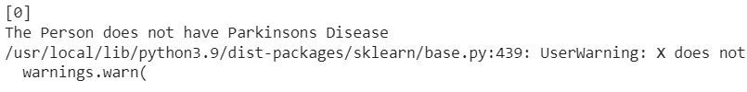
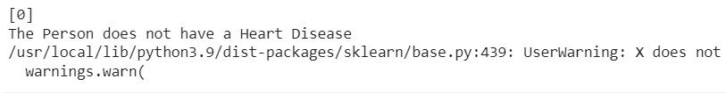
Output:-
Parkinsons
2) Heart

Slide 15

3) Diabetes

Slide 16
DataSets used
Parkinson
https://www.kaggle.com/datasets/vikasukani/parkinsons-disease-data-set
Heart
https://www.kaggle.com/datasets/johnsmith88/heart-disease-dataset
Diabetes
https://www.kaggle.com/datasets/mathchi/diabetes-data-set

Slide 17
Application
The multiple disease prediction model can be used in various healthcare settings, including clinics, hospitals, and research institutions. Here are some potential applications:
Early Disease Detection: The model can be used to detect diseases early, allowing doctors to provide earlier intervention and potentially save lives.
Patient Triage: The model can help healthcare professionals prioritize patients based on their predicted risk of a particular disease, allowing them to allocate resources more efficiently.
Clinical Trials: The model can assist in identifying patients who are most likely to benefit from a particular treatment.
Population Health Management: The model can be used to analyze the health of a population and identify trends in disease prevalence.

Slide 18
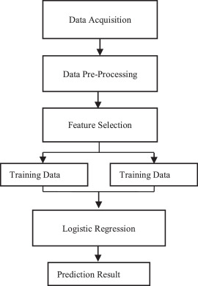
Use Case

Slide 19
Conclusion
In conclusion, a multiple disease prediction model using logistic regression has the potential to significantly improve healthcare outcomes by detecting diseases early, prioritizing patient care, improving clinical trials, and managing population health. By utilizing this model, healthcare professionals can make more informed decisions and provide better care to their patients.

Slide 20
Reference
https://numpy.org/doc/
https://scikit-learn.org/stable/
https://pandas.pydata.org/docs/
https://www.irjet.net/archives/V9/i3/IRJET-V9I3312.pdf

